Slide 1
Katy Perry- Roar
Goodwin’s Theory
Andrew Goodwin is a professor in Media Studies at the University of San Francisco.

Slide 2
Relationship Between Lyrics and Visuals
The lyrics of the song compliment the visuals that the audience are witnessing. The colours used are mainly green and a few other bright colours and links the visuals to the lyrics very well as the line “I’ve got the eye of the tiger, the fighter, dancing through the fire, cause I am a champion and you’re gonna hear me roar. Louder than a lion, cause I am a champion and your gonna hear me roar” brings the imagery of wildlife through the words “lion” and “tiger” and a jungle which relates to the colours and the location of the video. The lyrics “I am a champion” relates to her powerful presence among the jungle and the aminals. During the first few shots we see Katy Perry walking around a wasteland of her destroyed plane alongside her boyfriend who comes across as self confident and arrogant who appears to make Katy carry his bags while he is taking photos. The scene directly mirrors the lyrics sung over it which are “So I sit quietly, agree politely, I guess that I forgot I had a choice, I let you push me past the breaking point, I stood for nothing, so I fell for everything”. We can see there is a link here and that the artist who is Katy Perry is creating a message of femininity and fights the concept of male dominance which relates and conflicts to the way she is treated by the male who appears to be her boyfriend. This is also shown again within the pre-chorus with the lyrics being “you held me down but I got up” and “you hear my voice… like thunder gonna shake the ground”. The visuals here relate as they show her as a strong female confronting her fears expressed through when the crocodile tries to attack her or when the tarantula is crawling on her shoulder.

Slide 3
Relationship between Music and Visuals
The music used is fairly up-beat and powerful. The bright colours used work well to create a positive atmosphere with the up-beat nature of the song. The body language used by the artist is very strong especially towards the end. The shots are cut to the beat and so the visuals link well with the music. Whenever the chorus is featured we see Katy Perry shown without fear and her strong attitude. This is very relevant during the first chorus as we can Katy Perry adjusting to the jungle and embracing her surrounding's and over coming her fears of the animals around her.

Slide 4
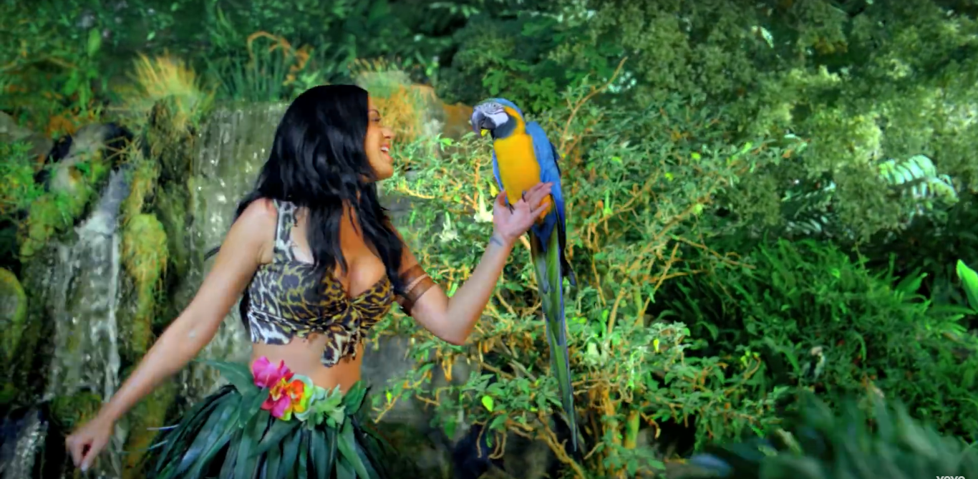
Relationship between Genre and Visuals
The genre of Katy Perry’s music video ‘Roar’ is pop. Pop is one of the more mainstream genres as it is ‘popular’ music. The producers of a music video aim to attempt to use typical genre techniques and themes so they can attract an audience from their massive demographic. Katy is seen in almost every shot within the shot as it largely revolves around her due to her being the main character. This technique is used as an attempt to sell the artist directly from the music video.

Slide 5
Emphasis on ‘Looking’
The camera angles used are very stereotypical of the pop industry. There are a large amount of medium shots and close ups of Katy Perry during the music video. This has been done to show the idea of a male gaze. This is best done through the use of close ups as it highlights the artists appearance in a lot of detail. The male gaze is a theory created by Laura Mulvey suggesting that the camera is usually gendered masculine and objectify women with sexual overtones. They may have over-sexualised Katy Perry in order to make the product sell more effectively. We see in the scene in which Katy walks out of the cave in a new outfit of which she is wearing very little clothing. During this shot the camera movement and audio increases. The reason she wears the outfit us so she can attract an audience of males and so will achieve a larger target audience. This technique is commonly used on music videos. This could be argued to have had a significant impact on the video and so increase the popularity of the video. This therefore could create voyeurism of the artist.

Slide 6
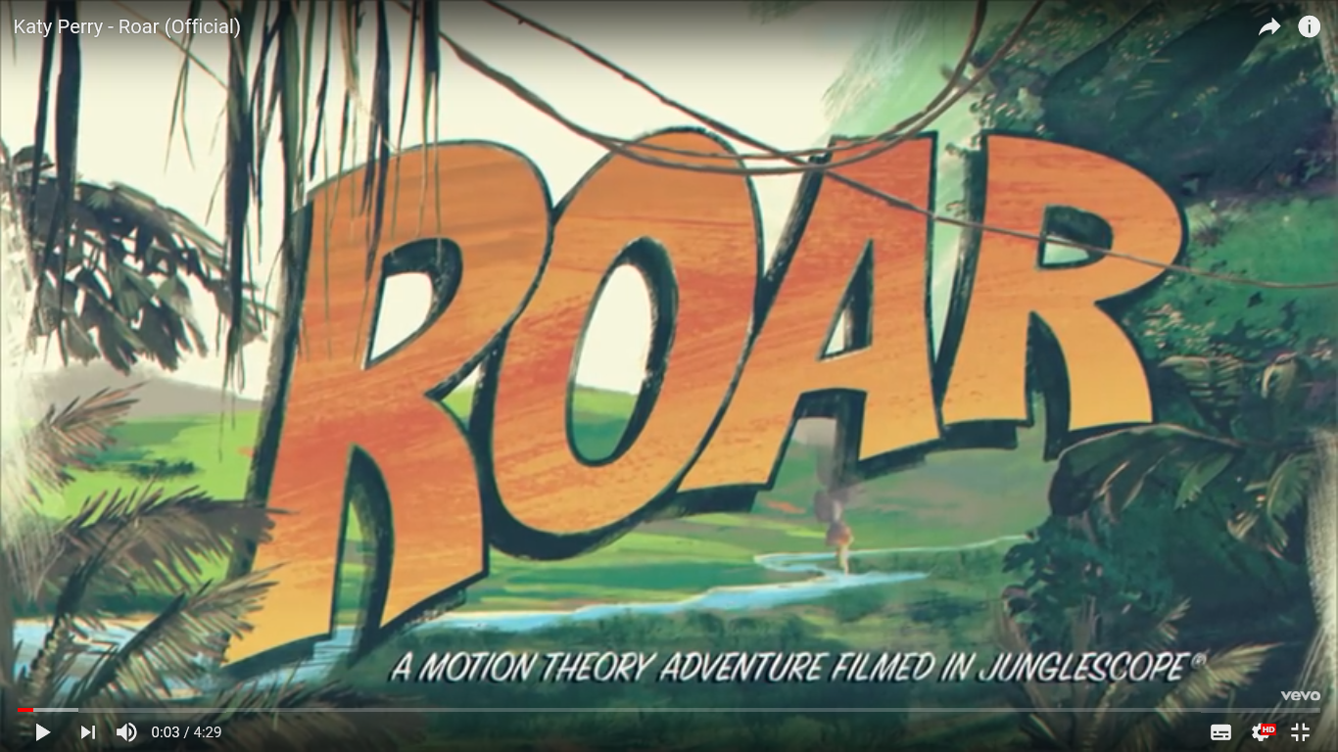
Intertextuality
The music video features a great variety of intertextuality. During the first scene we see straight away a man using a phone and is shown as product placement as the Nokia logo is branded central within the image. Another intertextuality is also shown with the location and the scene especially when she is vine swinging as it is a direct reference to the cinematographic product ‘Tarzan’.
The opening of the Video is made to look like a comic book. This allows the audience to believe we are entering a different world.
This title gives it a film like style.
We also see ‘the end’ following the theme of the music video being like a film.

