Slide 1
Digipak Analysis
Camo & Krooked ‘Above and Beyond’

Slide 2
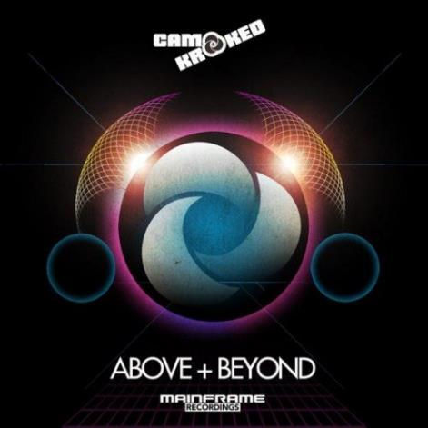
-The Artist Name is there to inform who the album is produced by and helps the artists promote themselves and the Artist Logo in the centre of the album is what stands out the most and therefore is the main attraction and aims to stand out on the shelf with the colours used.
-The Name of the Album title is in bold and is the largest size font which makes the title stand out the most.
-The colours used are bright. The circles are in line with the lights which possibly mirrors the performance of the live band. The blue coloured shapes with the black background fit the drum and bass theme very well as its matches the bright neon colours used against a dark background and could suggest the theme of space.
-There is also the Record label as the bottom of the CD which follows the stereotypical CD cover.

Slide 3
-The Artist Logo is repeated again on the back which is used to promote and reminds the audience who the CD is by.
-We can see from the track list that it has been separated into 2 separate discs and also shows you the number each track is so you can quickly find the song.
-There is 3 record labels shown on the back. One of which we also see on the front. These are the record labels that Camo & Krooked are signed to.
-There is also the Bar code which is a feature on every official product.
-We can also see that there is a Disc 2 which is from Mainframe Recordings which has a range of other songs from artists from the record company and helps promote those artists using the popularity of Camo & Krooked.

Slide 4
Chase and Status ‘No More Idols’

Slide 5
-The image shown on the cover is of a british bulldog and could suggest a stereotypical theme of violence and anger. However it does seem to used quite randomly and for abstract as does not reference to there music.
-The colours used are Black and Yellow which connotes a theme of a hazard or warning and matches the background of the bulldog very well. The font is big and bold which along with the bulldog helps connote a feeling of danger and could make the audience have a feeling of the album being intense. The font used is easily read.

Slide 6
-The back of the album follows the stereotypical back covers. The theme of the yellow with the bold font against the black background follows and stands out.
-There is also logos shown on the back cover which are used to help promote the album.
-There is also the barcode which is on every official product and is used when someone goes to buy the item.
-The tour poster also follows the theme of the Black and Yellow colours with the bold font and the picture of the bulldog behind.

Slide 7
Linkin Park ‘Living Things’

Slide 8
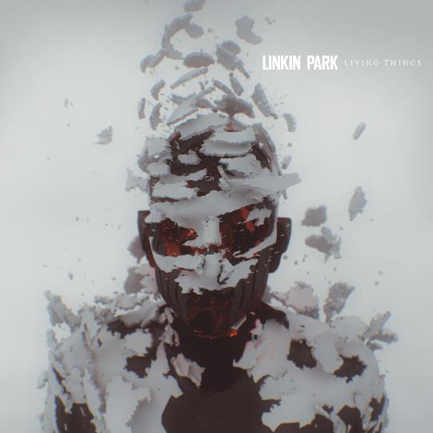
The front cover contains an image of a men which appears to have been digitally rendered to make it look a layer of skin floating up. This same feature has been used in different formats to help promote the album. The skin peeling off could signify that the band feel comfortable in their own skin.
The title on the front cover is all in caps and sans serif which gives it a very serious tone. The font of the band name is larger than the albums name which shows that the name of the band itself is given more importance than the albums name. A reason for this may be because linkin park is a very famous band known in many regions. The name works as a unique selling point as it is only other element on the front cover than the album name and shows who the album is by.

Slide 9
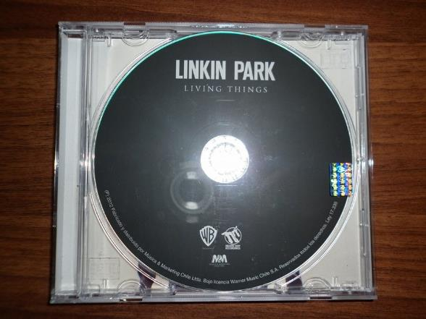
-The CD is very dark using a dark grey colour and uses white font for the text. The album name is a sans serif font like it is on the front cover while the bands name is above the album name and is in a larger font and using a sans serif font. The white against the dark background makes it easier to read as oppose to if the text was in black where it would be more difficult to read.
-We can that there are logos also on the CD. This shows the album was released under Warner Bros Records and Machine shop recordings. These logos are shown in white which helps them stand out.
-At the bottom of the CD around the rim we can see there is information that is regarding the copyright, release of the album and manufacturing information.

Slide 10
-The inlay contains an image of some rocks levitating in the air and appears to be forming a shape of a man and could connote a sense of mystery and is a very unusual image.
-The colours used are dark and against a white background so the detail stands out very well.

Slide 11
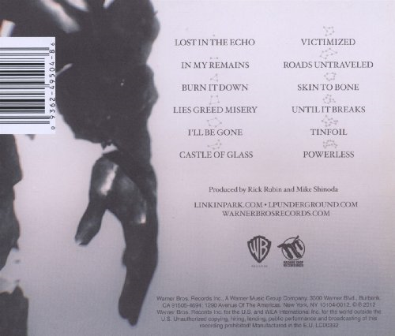
-The back contains an image of a hand and a forearm. This forearm links to the inlay as it appears to look like it has been made out of rocks and so is very similar to other images used for the promotion of the album. The record labels logos are again shown on the back cover underneath the bands and record labels website addresses. The list of the tracks on the CD are shown above it. Above each of the tracks there are small shapes that appear to be made from stars joining together which could connote a sense of hope. The barcode is located horizontally at the top right of the back of the CD cover and is not misplaced as it keeps the album looking well presented and tidy.

