Slide 1
The Cardigans- I need some fine wine and you need to be nicer

Slide 2
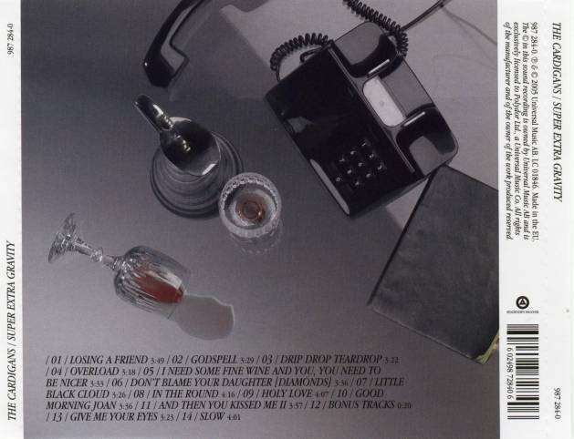
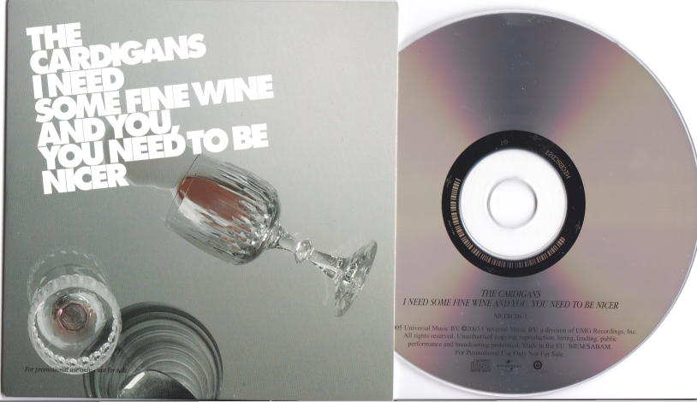
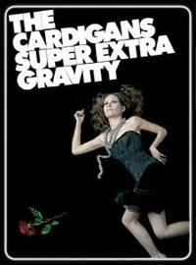
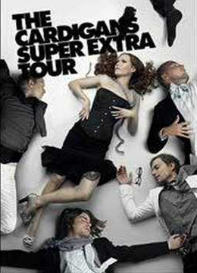
Album Cover
Single Cover
Press Pass
Tour Poster
Promo Shot

Slide 3
Cinematography
In the conceptual sections of the music video, there is wine being spilled which is used as a promotional tool on the album cover and single cover and also connects to the title of the song ‘I need some fine wine and you need to be nicer’. The woman who is the main singer is central and shown as the most important. There is also a lot of close up shots. There is an overhead shot on her which directly links to the album cover and is also used on the tour poster and press pass. There is also another overhead shot which shows the location as very messy.

Slide 4
Editing
The Album covers are almost screenshots of the sections in the videos. The edits are fairly fast paced which follows the genre of the music video. There is a jump cut edit when she switches her face to smiling on the floor which represents the genre. There is also cross cutting. When the music changes the wine smashes.

Slide 5
Performance of Band
Most of the band are using musical instruments mainly guitars but there is also drums. The woman is central which shows she is the main singer. They all play very quick to keep in with the fast beat and move around a lot especially the woman who is the main singer.

Slide 6
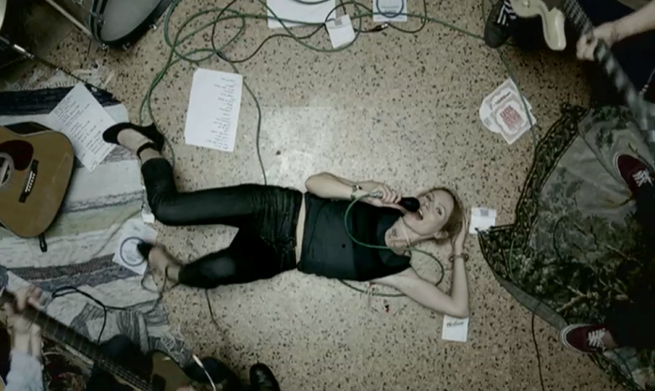
Mise-En-Scene
The location is very messy and the area is very small following the stereotypical rock video. There are instruments and pieces of paper and other items on the floor. The Clothing worn is mainly black and dark colours. The main singer who is a women is also seen wearing lingerie. The wine is used as a prop regularly throughout the video and is used as a promotional tool on the Single cover and Album cover. The Dog and Cat is also a prop and represents the women and the man arguing and so is mirroring the lyrics. The Lighting used is low key lighting which keeps in with the genre of the music. In the performance parts of the music video no make up is worn so keeps in with the genre however in the narrative parts make up is worn.

