Slide 1
Print Advert Analysis

Slide 2
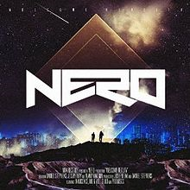
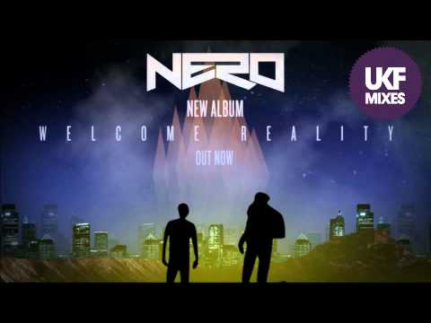
Nero-Welcome Reality
-The album uses the artist logo and the text style is identical to the album cover which creates a sense of continuity through the album, artists and promotions.
-The art used in the poster is very similar to the art used on the front cover of the CD. A reason for doing this could be to ensure the audience becomes familiar with the image so they know what they are looking for when going to buy the CD. It also creates a strong link with the promotion and the actual front cover of the CD.
-The text used is bold and so it stands out well on the poster and allows people to see it more clear if they were looking at it from a distance. Also the title stands out as it is in a larger font size and makes it clear who the album is by.
-The two people are much more zoomed in on the poster than the front cover of the album. The two figures are a symbolic representation of the artists and so the audience can recognise them.
-The word ‘New’ confirms to the viewers that the album is new and contains there newest songs.
-The colours used are also very similar to the colours used on the front cover of the album and so creates a strong link between the promotion of the album and album itself. The imagery appears to show a city on both and bright lights coming up towards the sky.

Slide 3
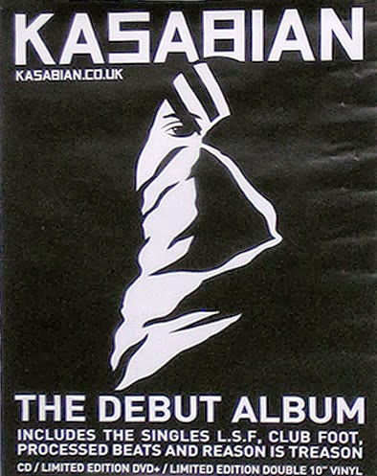
Kasabian- The Debut Album
-The Band advertise the website under the title which allows viewers of the advert to find out more information and allows the band to further advertise themselves. This could help the band grow as people may view the website and find tour dates etc.
-The font is the typical font that Kasabian usually use. The logo is also the logo Kasabian use keeping a link between there products and advertisements. This makes it obvious that the album is there’s and by using the same image for the front cover of the CD and poster it allows buyers of the CD to know what they are looking for when buying the CD.
-The main image on the poster of the man blends in very well with the background. This creates a better overall look rather than it looking like an actual image on top of the background layer.
-At the bottom of the poster they have told the different ways you are able to listen to the music such as on CD, Limited Edition DVD+ and Limited Edition 10” Vinyl. This lets the target audience know that there are more ways to listen to the music rather than just CD and so may attract a larger amount of buyers.
-The poster uses the typical style of an advertisement. Using larger font towards the top and getting smaller towards the bottom. The font is all bold and allows readers to read it easier and stands out better than if it wasn’t in bold. The font is also in white against the black background making it easy to read.

